Slide 1
2:30-3:30: Azure Search

Slide 2
Azure Search
Notes:
Include a brief demo of the published bot

Slide 3
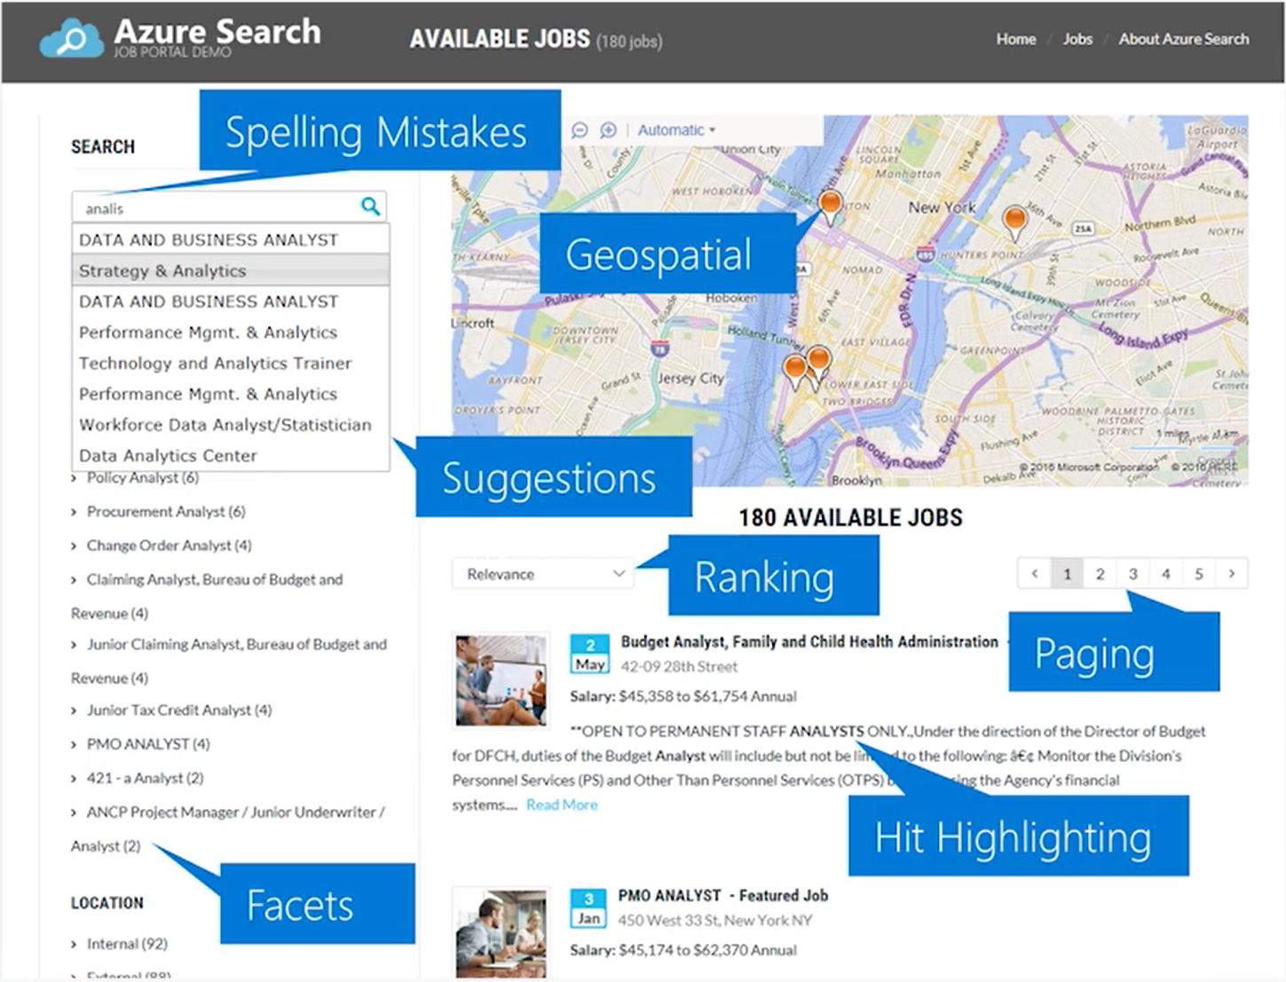
Azure Search
Notes:
Show flipkart
Azure Search is a search-as-a-service solution allowing developers to incorporate great search experiences into applications without managing infrastructure or needing to become search experts.
Developers look for PaaS services in Azure to achieve better and faster results in their apps. While search is a key to many types of applications, web search engines have set the bar high for search. Users expect: instant results, auto-complete as they type, highlighting hits within the results, great ranking, and the ability to understand what they are looking for, even if they spell it incorrectly or include extra words.
Search is a hard and rarely a core expertise area. From an infrastructure standpoint, it needs to have high availability, durability, scale, and operations. From a functionality standpoint, it needs to have ranking, language support, and geospatial capabilities.

Slide 4
Typical workflow
Provision service
Create an index
Index data
Search an index
Azure Search
Notes:
Show alice.unearth.ai
Typical Workflow:
Provision service
You can create or provision an Azure Search service from the portal or with PowerShell.
Create an index
An index is a container for data, think "table". It has schema, CORS options, search options. You can create it in the portal or during app initialization.
Index data
There are two ways to populate an index with your data. The first option is to manually push your data into the index using the Azure Search REST API or .NET SDK. The second option is to point a supported data source to your index and let Azure Search automatically pull in the data on a schedule.
Search an index
When submitting search requests to Azure Search, you can use simple search options, you can filter, sort, project, and page over results. You have the ability to address spelling mistakes, phonetics, and Regex, and there are options for working with search and suggest. These query parameters allow you to achieve deeper control of the full-text search experience.

Slide 5
Knowledge mining with Azure Search
Cognitive search creates searchable information out of non-searchable content by attaching AI algorithms to an indexing pipeline. AI integration is through cognitive skills, enriching source documents en route to a search index.
DAY 3!
Azure Search
Notes:
Looking to do more than what you’ve seen? I’ve brought Rodrigo Souza to explain Cognitive Search and where you can learn more

Slide 6
2:30PM-3:45PM https://github.com/Azure/LearnAI-Airlift
Lab 4: Azure Search

